Slide 1
UP – an alternative method
Use Case
2016

Slide 2
Agenda
Introduction to Unified Process – an alternative method
Core practices
Agile Unified Process
Comparison with XP and Scrum
Goal
Obtain general knowledge about basic principles in UP Know
Purpose of typical activities in each phase in UP
Types of artifacts that may be created in each phase
How models are refined and extended throughout iterations
How use case ranking is applied in planning
How adaptive planning is applied in UP Be able to
Write a use case

Slide 3
Literature
Scott W. Ambler: A Manager’s Introduction to The Rational Unified Process (RUP) (introduction with focus on disciplines)
http://www.ambysoft.com/downloads/managersIntroToRUP.pdf
Fronter
Leffingwell - chap 19 - use cases

Slide 4
UP is a generic process framework
UP is adaptable framework which can be specialized for a very large class of software systems
RUP (Rational Unified Process) is commercial IBM product http://en.wikipedia.org/wiki/Rational_Unified_Process
OpenUP is open source version
http://epf.eclipse.org/wikis/openup/
Basis Unified Process (BUP) is for small and agile projects https://www.eclipse.org/proposals/beacon/Basic%20Unified%20Process.pdf
Agile Unified Process (AUP) is another simplified version of UP http://www.ambysoft.com/unifiedprocess/agileUP.html
Many more versions exist – many companies have their own instance(s)

Slide 5
Software Development
Waterfall | UP | Agile (Scrum/XP)
Sequential Process All design up front Process heavy | Iterative Can be process heavy | Iterative Incremental Can be process light

Slide 6
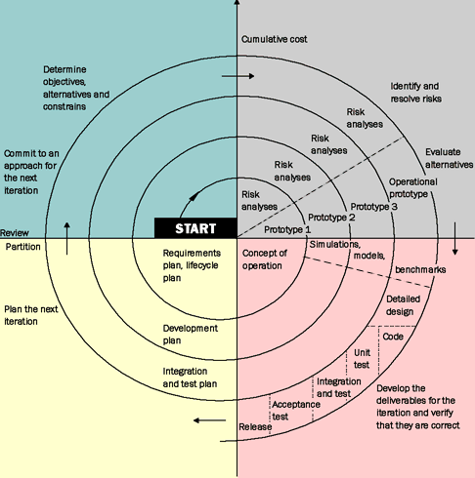
Background for Unified Process
Boehm’s spiral model

Slide 7
Unified Process Principles
Iterative and incremental
Use-case driven
Risk driven
Coverage
Risk
Business value
Architecture centric
Visual modelling
Demonstration based
Roundtrip engineering
RUP/UP is Use-Case driven and heavily reliant on the Unified Modeling Language or UML.

Slide 8
Iterative Development
Development is organized into a series of short fixed-length mini projects called iterations
The outcome of each iteration is a tested, integrated and executable system
An iteration represents a complete development cycle (mini waterfall): it includes its own treatment of requirements, analysis, design, implementation and testing activities
The system grows incrementally over time, iteration by iteration
But this you already know

Slide 9
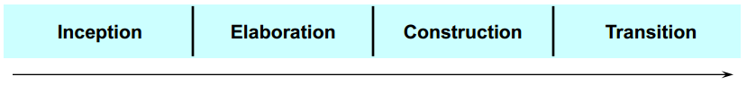
Phases of Unified Process
A Unified Process project organizes the work and iterations across four major phases:
Each phases has a mile stone:
Inception: Define the scope of project (incl. go/no-go)
Elaboration: Plan project, specify features, baseline architecture (price and time)
Construction: Build the product
Transition: Bring the system into use (technical and organizational)

Slide 10
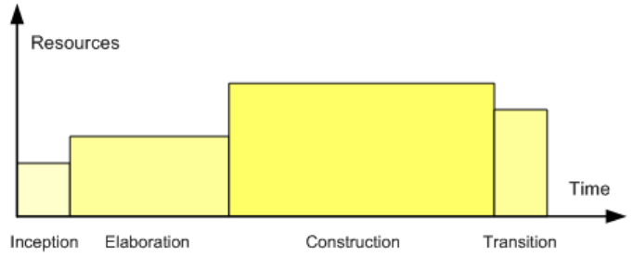
Relative Size of the Four Phases
Senior developers /architects establish architecture in the elaboration phase

Slide 11
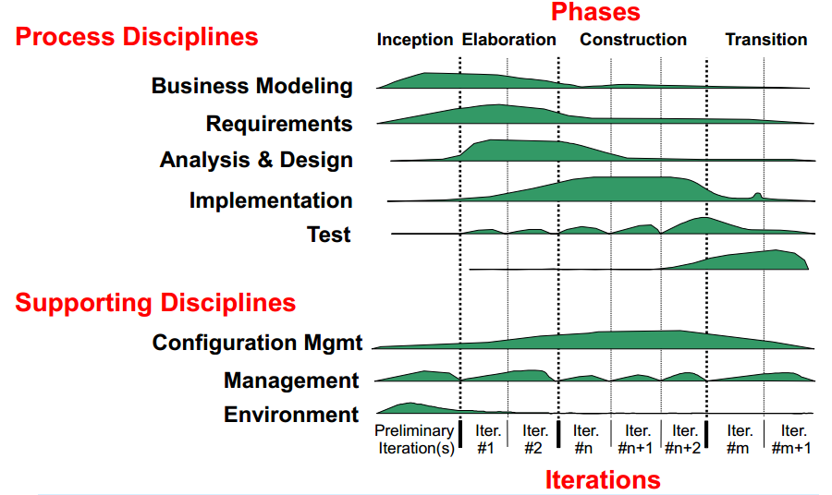
UP disciplines

Slide 12
In an iteration you
walk through all
disciplines
UP disciplines

Slide 13
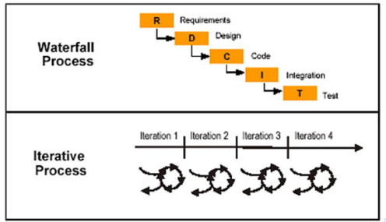
When Should you Use UP?
You could argue that you shouldn’t use UP for:
Simple or well-known systems, where it might be feasible to sequentially define the whole problem, design the entire solution, build the software, and then test the product
You could argue that you should use UP for:
Complex and sophisticated systems which evolve incrementally in cycles

Slide 14
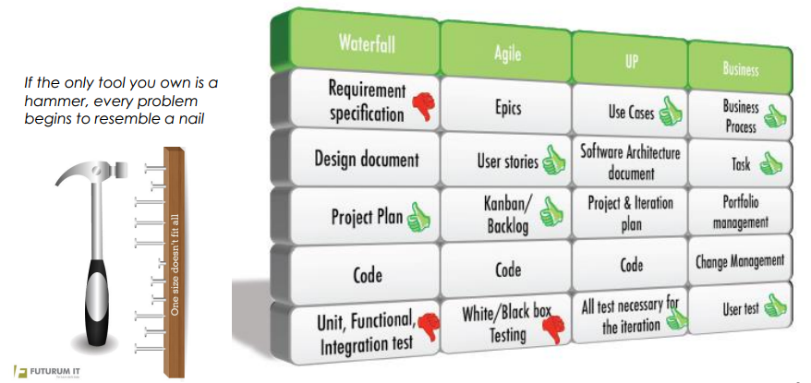
Why bring UP “back to life”?
Comparison of methodologies

Slide 15
Challenges in many IT projects
Business do have a need for a budget
Business do need a contract when buying software
Business do need to know when and what for their planning
EU tender rules
6 weeks to deliver your bid
Max. 20% of the requirements are allowed to be changed during the project

Slide 16
UP – a hybrid between waterfall and agile

Slide 17
UP <> SCRUM
 | UP | SCRUM
Approach | Iterative | Iterative
Cycle | Formal Cycle is defined across 4 phases, but some workflows can be concurrent. | Each sprint (iteration) is a complete cycle.
Planning | Formal project plan, associated with multiple iterations, is used. The plan is end-date driven and also has intermediate milestones. | No end-to-end project plan. Each next iteration plan is determined at the end of the current iteration (NOT end-date driven). Product Owner (Key Business User) determines when the project is done.
Scope | Scope is predefined ahead of the project start and documented in the Scope document. Scope can be revised during the project, as requirements are being clarified, but these revisions are subject to a strictly controlled procedure. | Instead of scope, SCRUM uses a Project Backlog, which is re-evaluated at the end of each iteration (sprint).
Artifacts | Vision/Scope Document, Formal functional requirements package, system architecture document, development plan, test plan, test scripts, etc. | The only formal artifact is the operational software.
Type of Project/ Product | Recommended for large, long- term, enterprise-level projects with medium-to-high complexity. | Recommended for quick enhancements and organizations that are not dependent on a deadline.

Slide 18
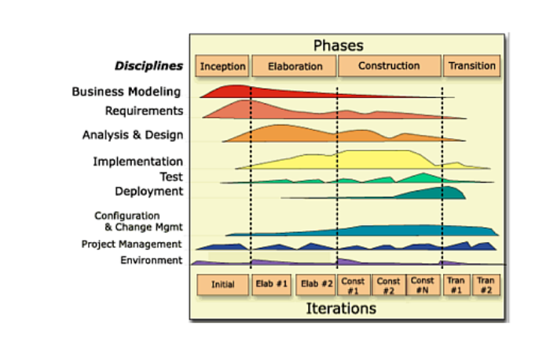
Exercise 1
Where would you place Scrum and XP in this UP figure?

Slide 19
User Stories <> Use Case
User Stories | Use Cases
Promise of a conversation | Record of a conversation
A way of prioritizing work | A way of describing requirements
Demands questions | Demands answers
What & Why | How
Business | System

Slide 20
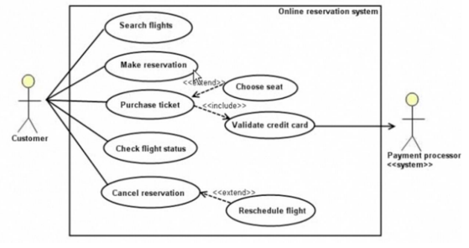
UP Core practises – use-case driven
Use cases capture the functional requirements of a system
Use cases describe the interactions between various actors and the system from the user’s perspective

Slide 21
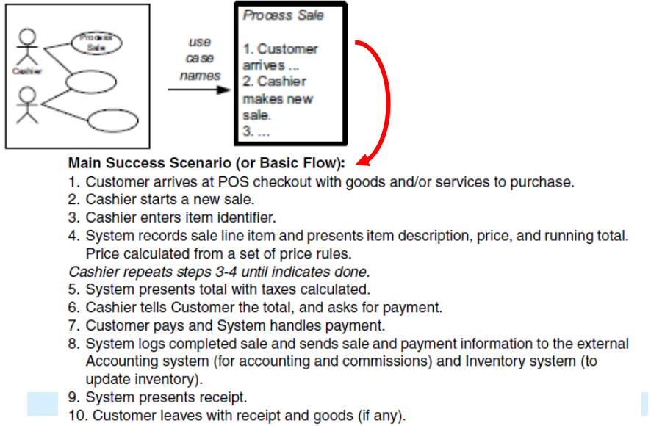
Use case example – Process Sale

Slide 22
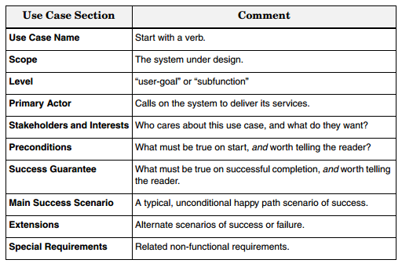
Use case description elements

Slide 23
Use case example: Process Sale (cont.)
Main success scenario (or basic flow):
The Customer arrives at a POS checkout with items to purchase.
The Cashier records the identifier for each item. If there is more than one of the same item, the Cashier can enter the quantity as well.
The System determines the item price and adds the item information to the running sales transaction. The description and the price of the current item are presented.
On completion of item entry, the Cashier indicates to the POS system that item entry is complete.
The System calculates and presents the sale total.
The Cashier tells the customer the total.
The Customer gives a cash payment (“cash tendered”) possibly greater than the sale total.
Extensions (or alternative flows):
2a. If invalid identifier entered. Indicate error.
7a. If customer doesn’t have enough cash, cancel sales transaction.

Slide 24
UP Core practises – risk-driven
Use cases are ranked according to the following criteria:
Architectural significant
If implemented, we are forced to design, build and test the core architecture
Business value
Features business really cares about
High risk
E.g. “be able to handle 500 concurrent transactions”

Slide 25
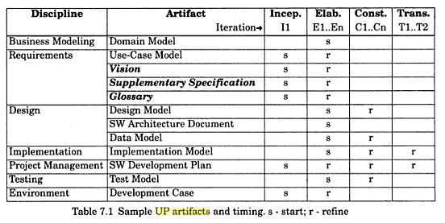
UP Core practises – Visual Modelling
UML modelling is central
An abstraction of the implementation (documentation)
A design tool (forward engineering)

Slide 26
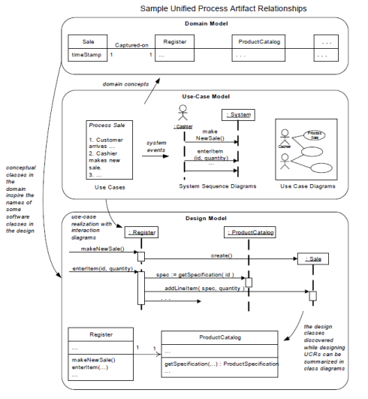
Traceability between models is important

Slide 27
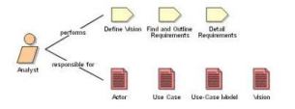
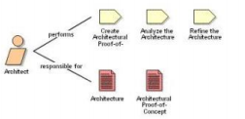
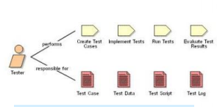
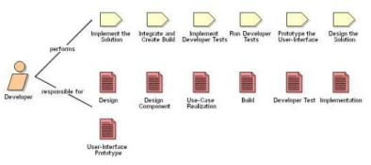
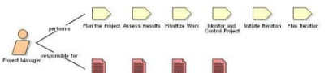
Unified Process - Roles
One person can have several roles

Slide 28


Customization of Unified Process
Many characterize UP as a heavyweight method, but almost everything is optional
All activities and artefacts (models, diagrams, documents …), except the code ☺
Invariant practices and principles
Iterative
Risk driven development
Continuous verification of quality
How to turn UP into agile version?
It is not meant by its creators to be heavyweight or un-agile

Slide 29
Agile Unified Process
Customizing UP
Prefer small set of UP activities and artefacts – keep it simple
Focus on early programming, not early documentation
Evolutionary Analysis & Design
Requirements and design are not completed before implementation
They adaptively emerge through iterations based on feedback
Agile models
Modelling must support understanding and communication, not documentation
Use simplest tool possible, e.g. sketching on whiteboard
Model in pairs – to discover, understand and share understanding
Use “good enough” simple notation; models will be inaccurate
Agile project management
No detailed plan for the entire project
High-level phase plan that estimates project end date and major milestones
Detailed iteration plans are done adaptively from iteration to iteration

Slide 30
Exercise
Try to list: Artefacts used in XP, Scrum and UP respectively
Try to list: Activities carried out in XP, Scrum and UP respectively
Try to list: Roles used in XP, Scrum and UP respectively
Try to list: Similarities between UP and XP/Scrum
Try to list: Differences between UP and XP/Scrum

